Slide 1


Normandy Tourism & Lodging
Data Analysis Final Project
Benoit Mormède - 08/11/2024

Slide 2

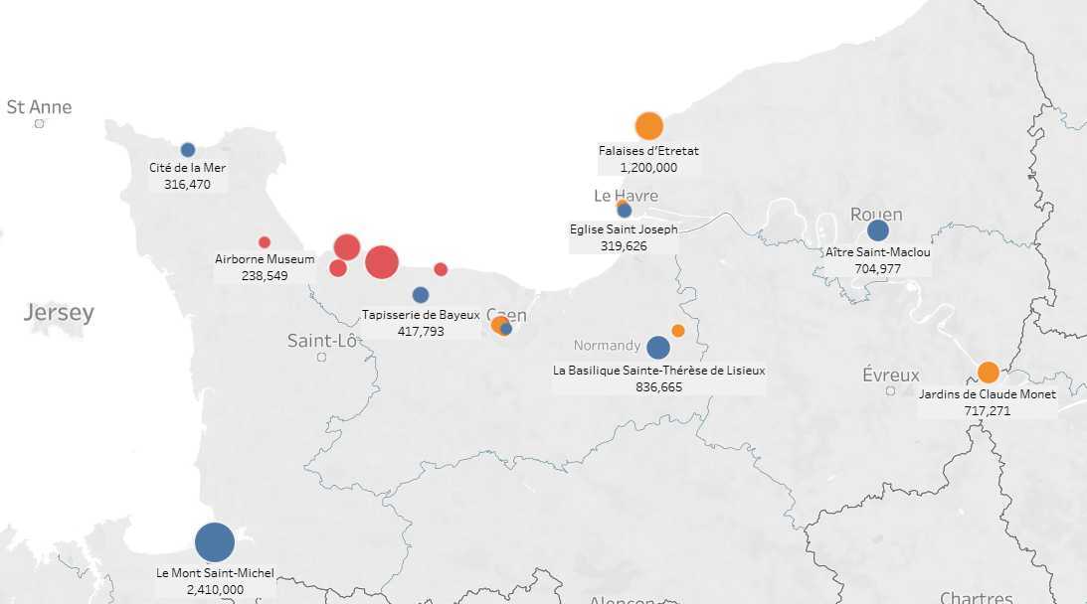







Data Analysis Case
The normandy region in France is rich in historical landmarks, beaches and landscapes
In 2023, it attracted >16 M visitors in the main sites and a demand for 45.5 M night stays*
What is the capacity & typology of the lodging offer?
What is the magnitude of “Tourism Pressure” and where ?
* https://pronormandietourisme.fr/

Slide 3



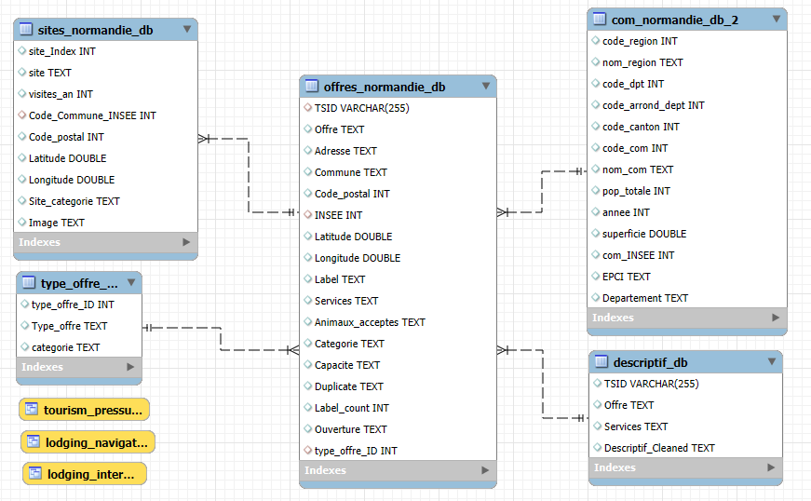

Data analysis process
Acquisition
Database
Visualization
Data Providers
Pro Normandie Tourisme
Lodging offers
20241024-Export-locations.csv
20241024-Export-hotels-campings.csv
NSEE database
Population Information by district
Population-francaise-communes.csv
Web search
Main touristic sites & affluence
Sites_normandie_db.csv
Data Wrangling
Import Data Bases
Link databases with indexes and foreign keys
Generate the Enhanced Entity relationship Diagram (EER)
Build queries & views to support visualization
Tableau Public
Import Views from MySQL
Create worksheets
Summarize in Dashboards for data exploration & visualization

Slide 4

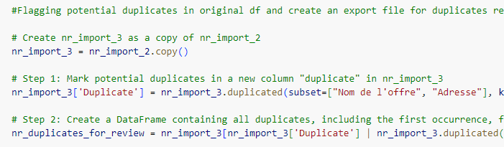
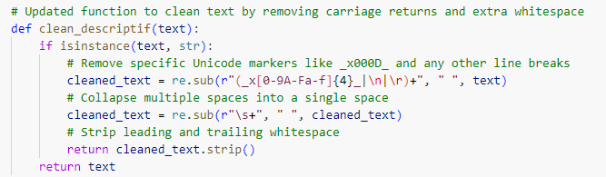
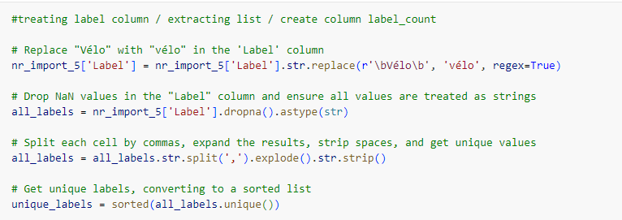
Data Cleaning & Wrangling
Imported various csv files
Vertical concat of 2 lodging files
Removing NaNs
Identifying duplicates
NaNs and duplicates exported in separate file to provide feedback to data provider
Columns dropping & renaming
Data type casting
Calculated fields (# of labels)
Regex functions to extract text, remove blanks, and create categorical data fields (opening scheme, labels list / database)
Splitting 1 data frame in 2 with Index link for optimization of database relationships in My SQL

Slide 5
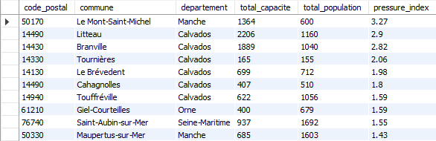
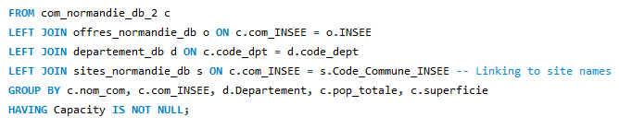
Database Structuring & querying
Importing individual databases
Checking data types
Creating indexes and foreign key
Establishing 1 : n relationships
Generating EER diagram
Running queries and generating views for visualization

Slide 6
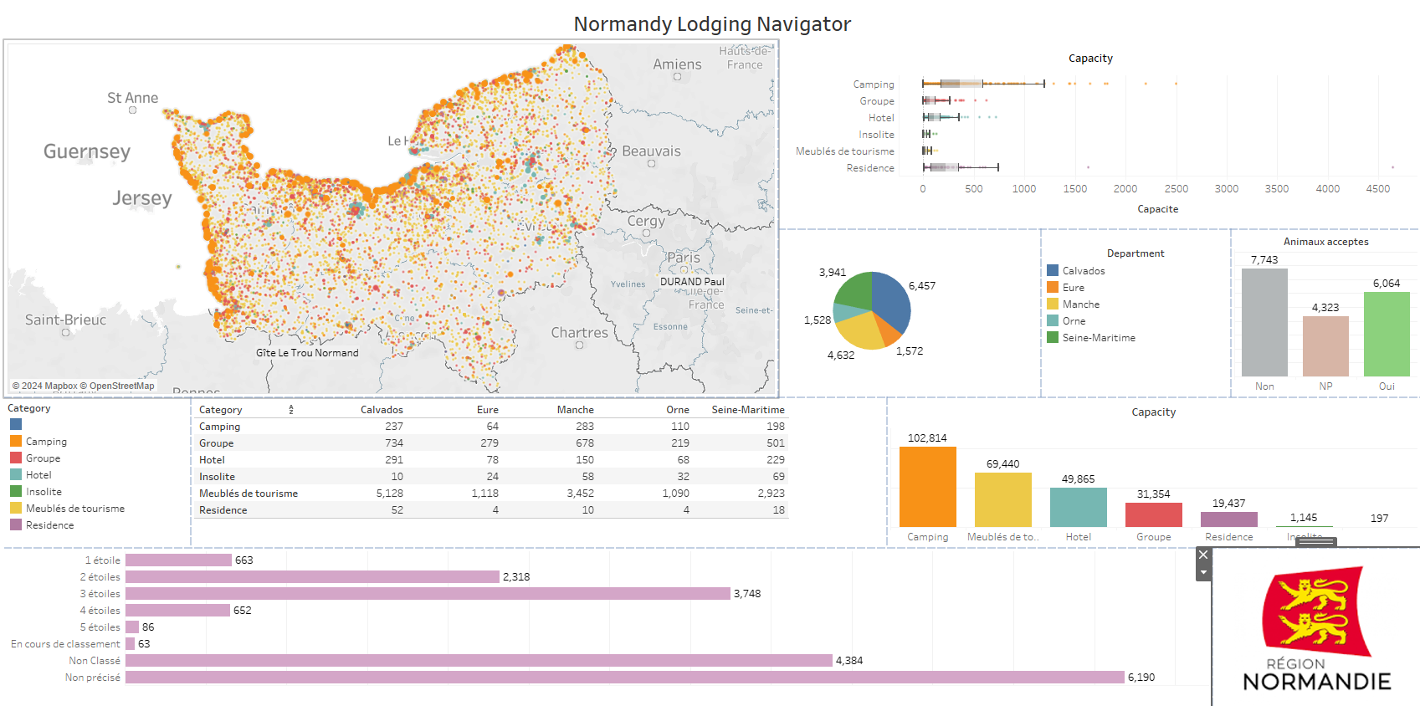
Data exploration & Visualization

Slide 7

Key Learnings
Managing the complete data analysis process from extraction to visualization is extremely challenging but a very significant learning exercise
Critical to have the end result of the analysis clearly formalized from the beginning
Identify clearly the output expected for each step: Python, SQL, Tableau
Important to avoid too many iterations in the data processing chain
Data (non) quality can have a strong impact on the process => scope reduction
Technical hurdles at every step of the way are to be expected
Time boxing of tasks is absolutely necessary
Knowing what the data manipulated represents is a great help, having an interest for it is even better
Difficult to examine / analyze big data frames in Pandas (XL helps)
Tableau is for display and requires quality & organized data (avoid aggregations, calculations)

Slide 8

Potential features improvement
Data quality, Technical challenges and time constraint have imposed a reduction of the features imagined at the kick off of the project
Possible features improvement :
Using an API to extract population information by district (INSEE)
Automate data feeding from Python to My SQL using sqlalchemy
Implement Natural Language Modeling (NLM) to identify keywords and their frequency in description
Extract lodgings price for correlation analysis, machine learning for predictive pricing
Tableau “Pressure Map” and fine tuning
…

Slide 9
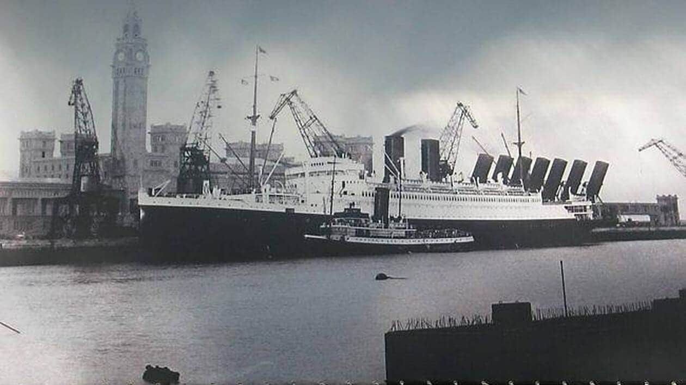
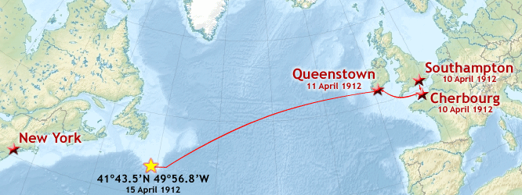
Thank you !
Benoit Mormede
CHERBOURG

